Slide 1
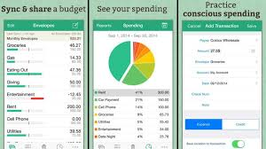
Budget Daily
A budget tracker for everyday life
Creator: Matt Reynolds
Github Link: https://github.com/mtreynolds55/everyday-budget

Slide 2
Presentation
My Computer would not let me input my screen capture video into this powerpoint, but I was able to create this link to a location that would play the video.
https://docs.google.com/file/d/1JGqijwCs53T9afERzwA9crRNNYYaz7gz/preview

